Slide 1
Types of Inheritance

Slide 2
Inheritance Types
Types of Inheritance depend upon the number of child and parent classes involved. There are five types of inheritance in Python:
Single Inheritance
Multiple Inheritance
Multilevel Inheritance
Hierarchal Inheritance
Hybrid Inheritance

Slide 3
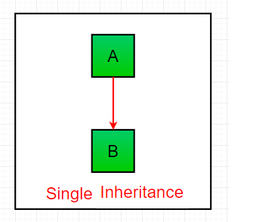
Single Inheritance
Single inheritance enables a derived class to inherit properties from a single parent class, thus enabling code reusability and the addition of new features to existing code.

Slide 4
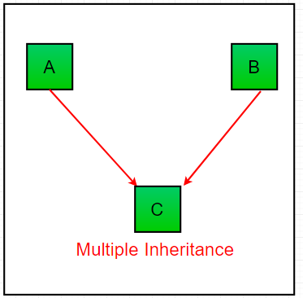
Multiple Inheritance
When a class can be derived from more than one base class this type of inheritance is called multiple inheritances. In multiple inheritances, all the features of the base classes are inherited into the derived class.

Slide 5
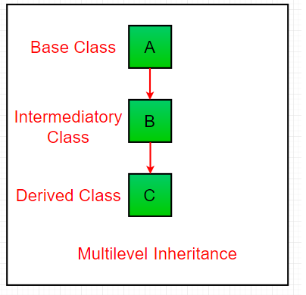
Multilevel Inheritance
In multilevel inheritance, features of the base class and the derived class are further inherited into the new derived class. This is similar to a relationship representing a child and a grandfather.

Slide 6
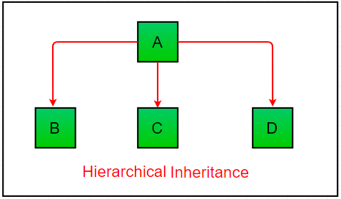
Hierarchal Inheritance
When more than one derived class are created from a single base this type of inheritance is called hierarchical inheritance. In this program, we have a parent (base) class and three child (derived) classes.

Slide 7
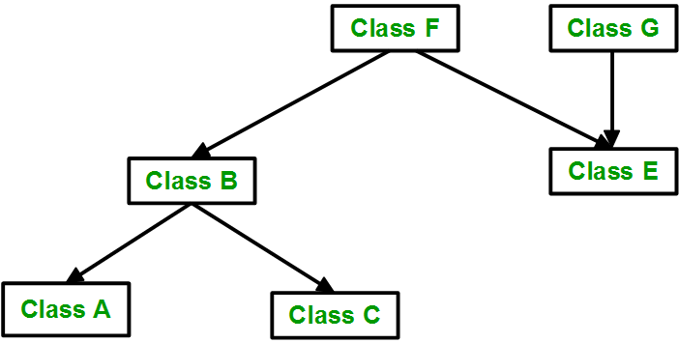
Hybrid Inheritance
Inheritance consisting of multiple types of inheritance is called hybrid inheritance.

Slide 8
Python Examples

Slide 9
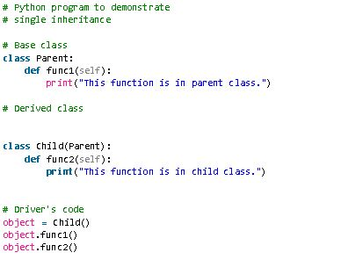
Single Inheritance

Slide 10
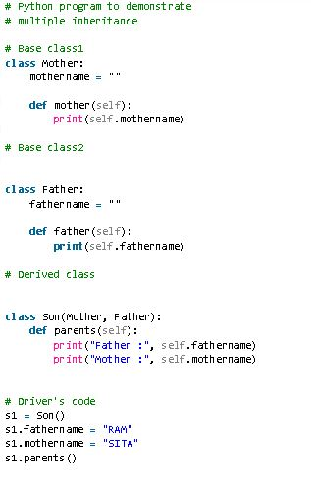
Multiple Inheritance

Slide 11
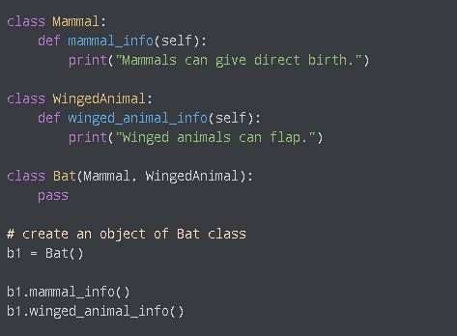
Multiple Inheritance

Slide 12
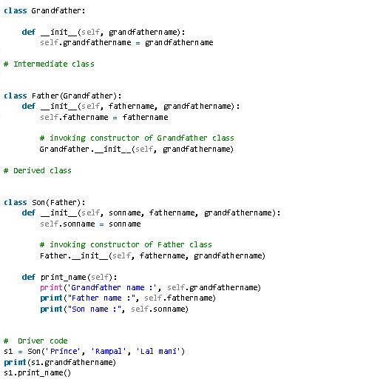
Multi-level Inheritance

Slide 13
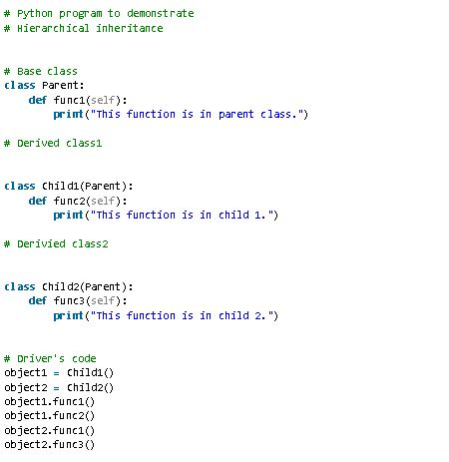
Hierarchal Inheritance

Slide 14
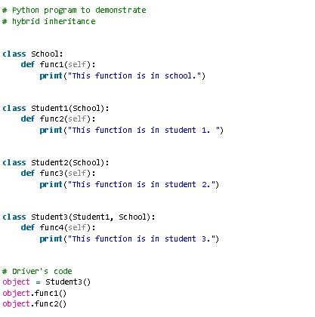
Hybrid Inheritance

Slide 15
Method Resolution Order (MRO) in Python
If two super classes have the same method name and the derived class calls that method, Python uses the MRO to search for the right method to call.

Slide 16
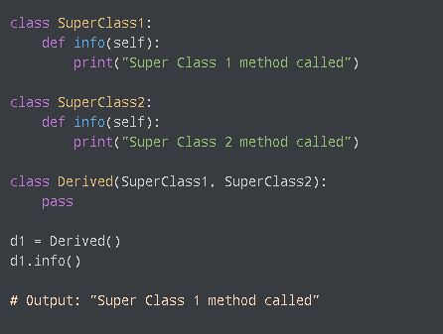
Method Resolution Order

Slide 17
Class Activity
Write a code on any inheritance example and demonstrate its type. Do not use single inheritance.

